Slide 1


Canteen Tech Vending Machine. . . . . …
A.Harshith
Sai Chandan
Prasanna
Sujith
Rajeshwari

Slide 2

Introduction :
Our project is about time and crowd management in college canteens.
It is on the over wastage of time in college canteens during break hours.
Looking into general sense, Everyone agree with the fact saying Our project is about time and crowd management in college canteens.that time is more precious factor in life.
On this note, looking into student’s life, many of them are not going to cope with their food being delivered for so long time!
We have put a little effort forward for “Time and crowd management in canteen”.

Slide 3



Problem :
Plenty of time is wasted in college canteens.
The normal canteen has heavy manual work.
Students are investing a lot of time in waiting for food and they don’t have time to have it.
Students have to wait for getting tokens, then they have to rush to get food from the counter. Meanwhile lot of time is wasted.
During this process of taking tokens and delivering the food, the server/workers have rush here and there to supply food items to the students.
All the students at time ask for their order to be delivered on limited number of people noting them down.
It is really a hard task for the one who managing orders to handle everyone with their choices.
While so many people miss use the tokens by taking a greater number of food items on a single token.

Slide 4
Remedy for the problem :
Based on the problem we thought of innovating a vending machine which vends food items in college canteens.
This will decrease the time consumption and also decreases the manual work.
The machine will serve the food by debiting money from the ID card which is recharged prior in the canteen.
Hence , there is no need of waiting for taking tokens.
Reduces the manual work of the servers,the only work that they have to deal. is to cook

Slide 5
Machine description:
The machine consists of ‘n’ number of containers which consists of different types of food items in it.
The cooked food is filled in the containers.
Every container has a separate IR scanners to decrease the time consumption.
IR scanner scans the barcode on the ID card.
This machine works on Arduino –UNO.
A program is dumped into the Arduino such that the food will be served only when the card has sufficient money for the selected item.

Slide 6
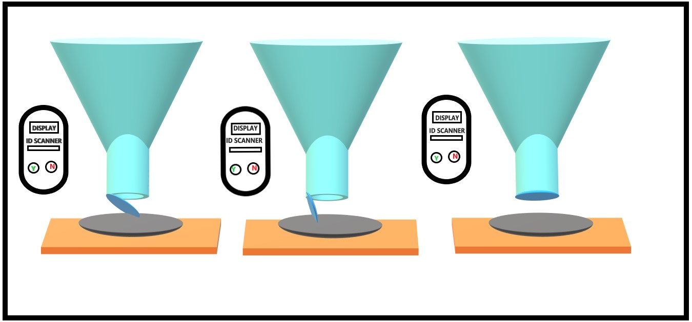
Machine layout:

Slide 7

Working :
STEP 1: The one who wants a particular food item should approach the appropriate container.
STEP 2: One should place their card in the scanner slot . If their is sufficient money in their account then it shows ‘OK’ button.
STEP 3:Place the plate and then Click ‘OK’ button.
STEP 4:The food will be served in the plate.

Slide 8
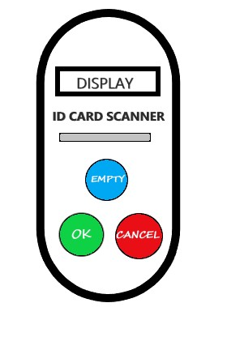
EXPLANATION :
ID card scanner : This scans the bar- code on the ID card .
Display :This displays the content in the display bar.
OK Button: Ok button is pressed once the order is conformed.
CANCEL : Cancel button is clicked if one want to cancel the order . This button will work only if there is no money in the account or if there is no food in the container.
EMPTY BULB: This bulb glows when there is no food in the container.

Slide 9
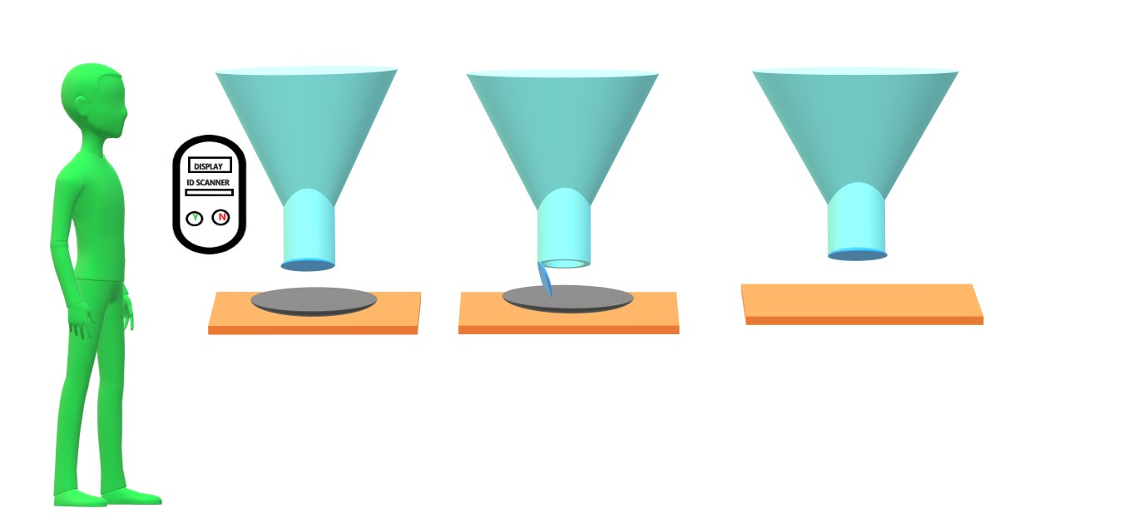

Slide 10
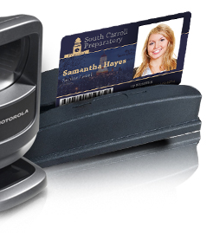
Recharging:
We should register our card using the
barcode on the ID card in the canteen.
And we should recharge it with some
amount in the canteen.
The ID card should be inserted so that
it will scan the bar code, if there is cash
in the account one could select the food
item that is required.

Slide 11
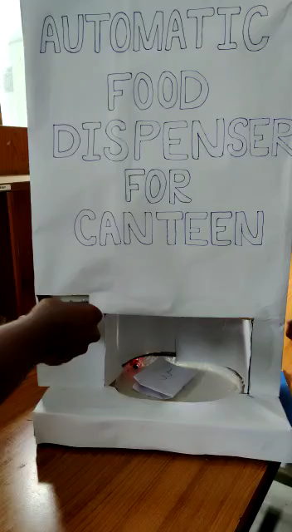
Prototype video:

Slide 12
The conclusion:
Reducing the waiting time in the large crowd and reducing manual work of supplies has been our main motto through out the process of finding the solution.

Slide 13


